Slide 1
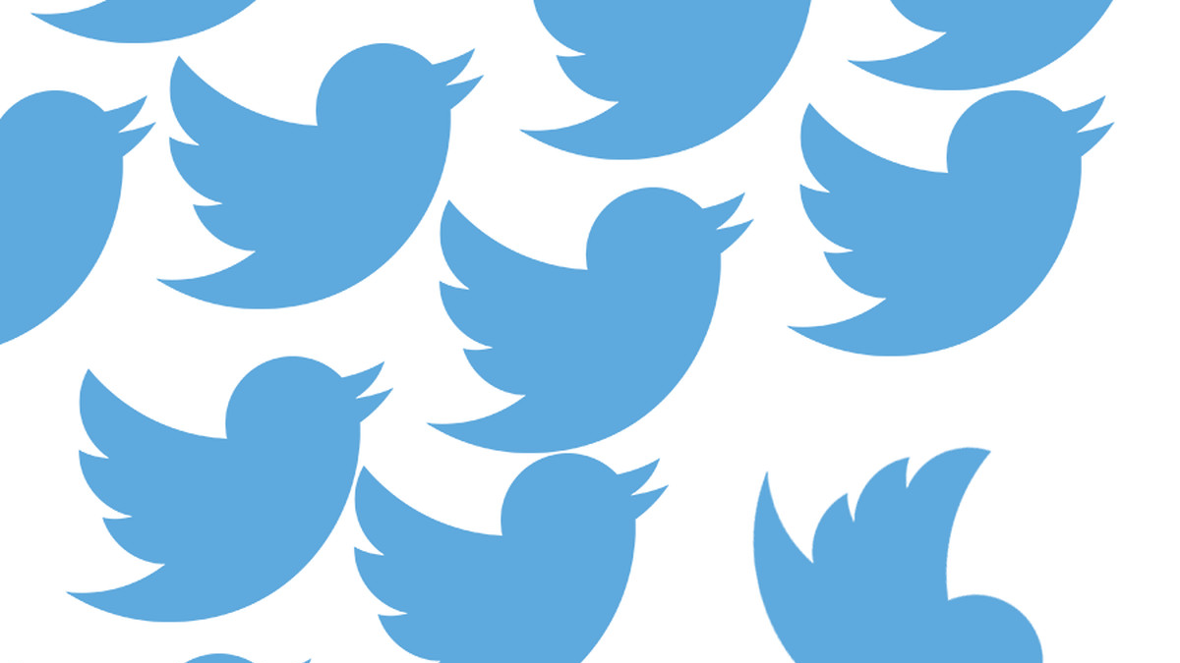
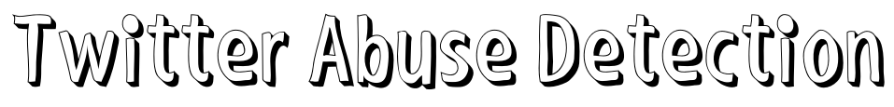
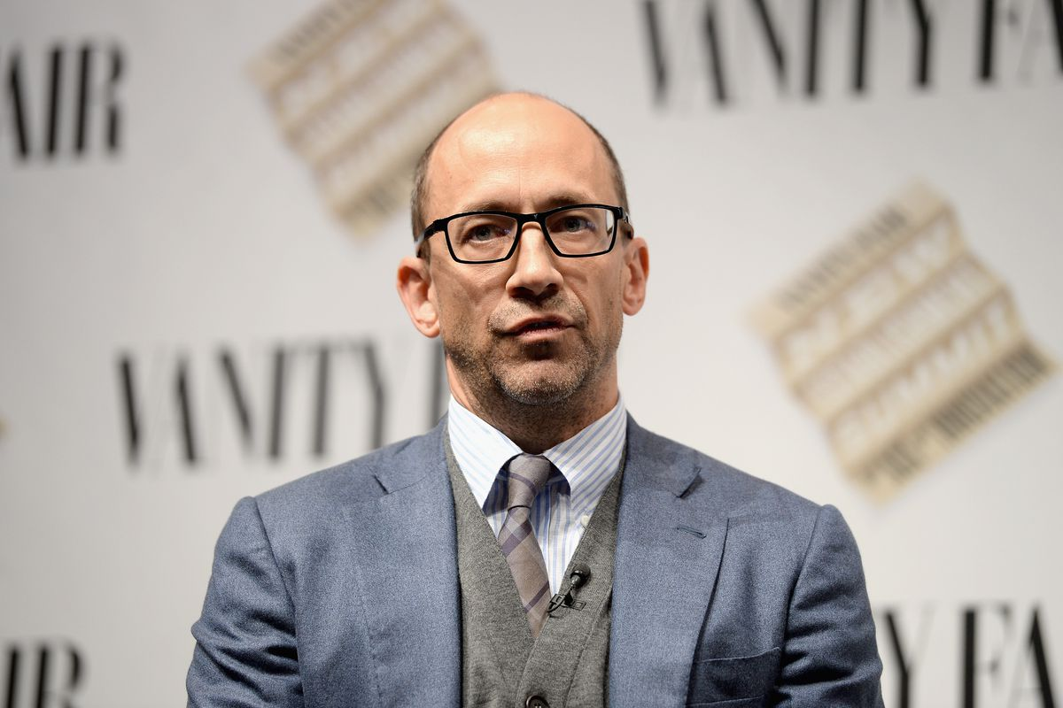
A comparison of Lexicon and Machine learning methods to detect abuse. While also exploring an experimental Supervised learning lexicon concept
“We suck at dealing with abuse and trolls on the platform and we've sucked at it for years”
Dick Costolo (2015) – Former Twitter CEO

Slide 2
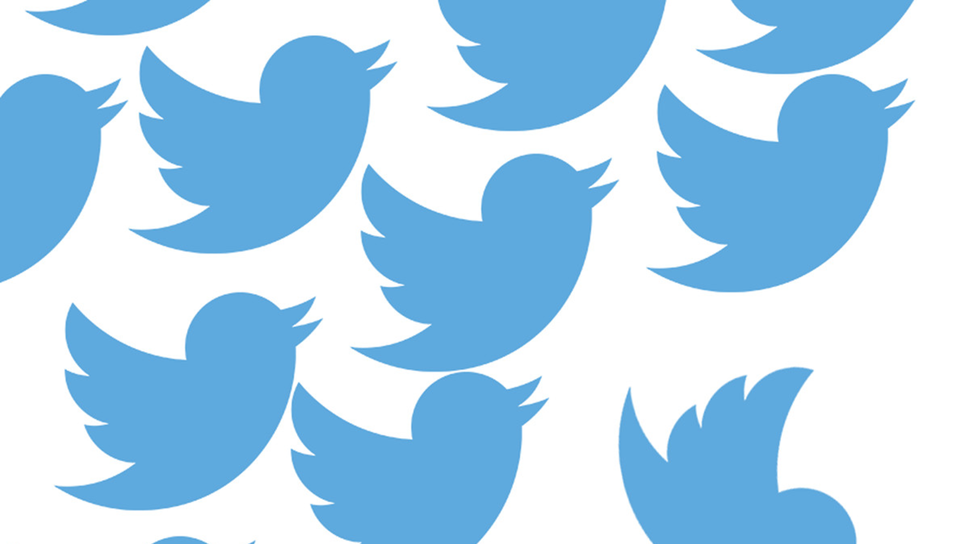
What is Twitter used for
Twitter is one of the early innovators of the social media bloom. As one of the market leaders Twitter has a vast amount of daily users. With an estimated 356 million monthly users. With so many users the is a lot of data produced constantly and at large volumes. With an approximate 500 million tweets created a day. Twitter allows for the bonds of community’s with people of similar interests connecting together. People use twitter to express their opinions on “ hot “ topics and give their thoughts out in to the web.
Twitter has been used by large cooperation's and academics alike to meticulously collect valuable information such as products sentiment and create marketability.

Slide 3
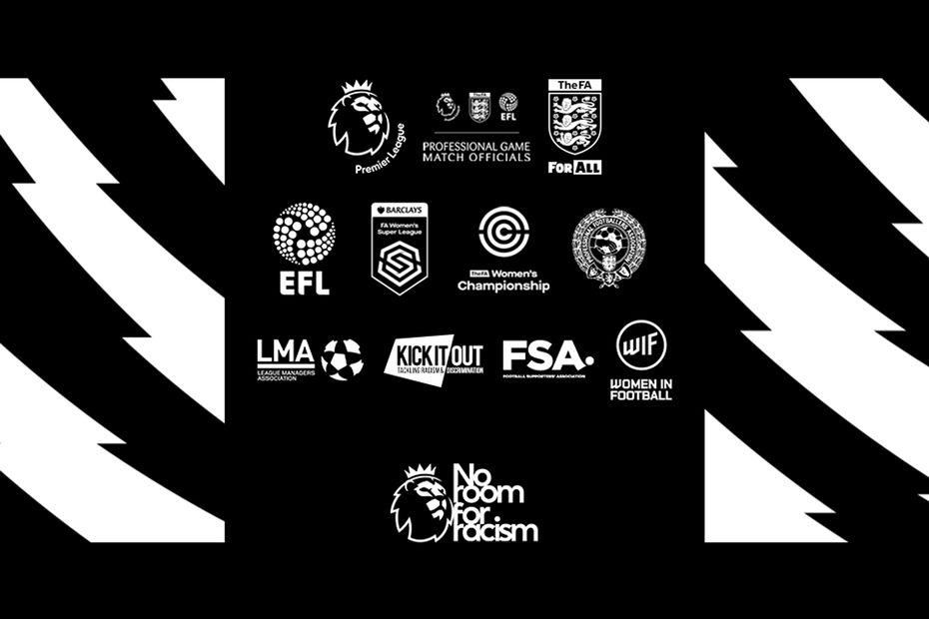
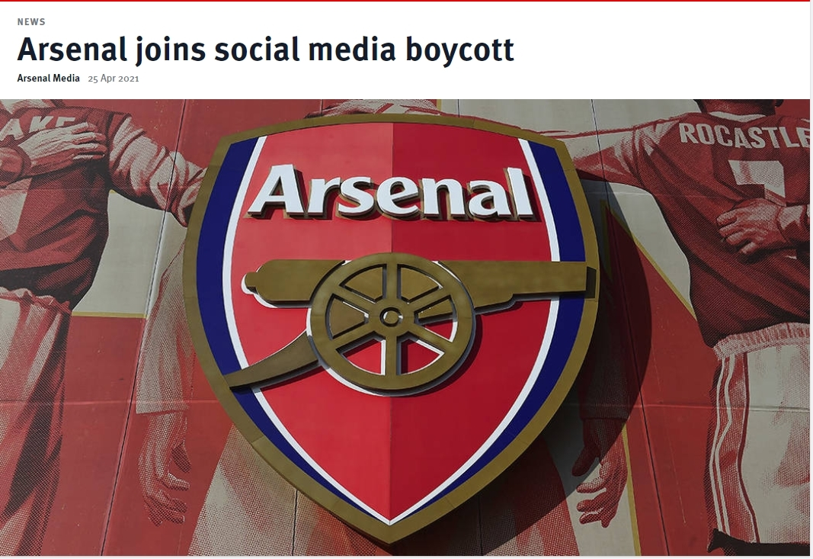
So what’s the problem?
Evidently Twitter with such a large user-base, suffers from its fair share of trolls and abusive comments. The abusive normality within Twitter and other social media stems from the power of anonymity given to users. Abuse has become such a dominant issue that large cooperation's and public figures alike, have discussed and followed up on social media blackouts, to attempt to create awareness of this issue. This can be seen through examples like, when the Premier league had organised a mass social media blackout amongst football clubs and similarly other sports like cricket
The abusive content found on twitter is very poorly regulated. With Twitter heavily relying on its “reporting” system where other users are expected to highlight abusive comments made by other users. This can be seen when Senior director Gasca mentiones in 2019, mentions only 38 percent of abusive content is flagged without the use of twitters report system.

Slide 4
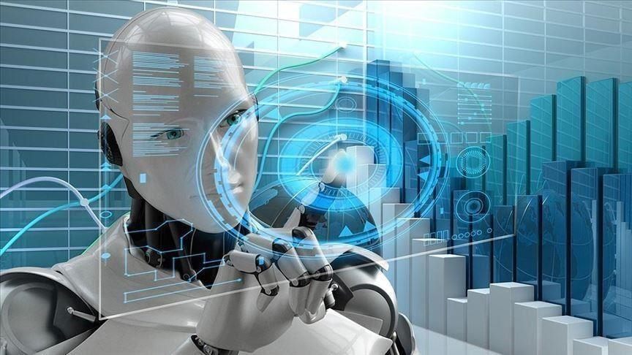
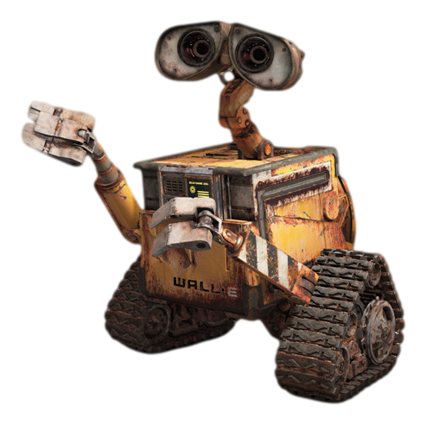
Creating an Automated Approach
To counter the reliance on manual reporting which can be both expensive and unreliable, it would be best to solve this issue through some sort of automated approach. A program that Is able to successfully read tweets and determine by itself if it is abusive or non abusive. To create such an automated approach there 2 main methodologies that can be considered for this particular task.
Machine learning and a Lexicon approach
Instead of trash, I pick up abusive tweets???
Machine learning?

Slide 5
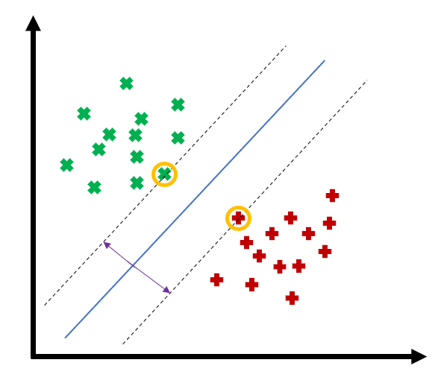
What is Machine Learning?
Machine learning is much less glamourous then having WALL-E pick out abusive tweets for us. Instead machine learning utilises complex mathematical formulae to create algorithms and programs that can learn through the use of supervised learning. These mathematical models involves the likes of Logistic Regression , Naïve bayes and many more. The machine learning model used in this project was the Support Vector Machines model (SVM).
Once fed adequate and thorough data, machine learning models are able to understand the data fed to them in numerical format. When new unseen data is then fed to the machine, it is able to classify and predict based on calculated assumptions from the data that it was trained on. Machine learning will allow us to create programs that can learn to predict and differentiate between an abusive tweet and a non abusive tweet.
THIS is a machine learning

Slide 6

What about a Lexicon?
A lexicon is another method that is often used in text classification and sentiment analysis. This methodology encompasses the use of a large corpus of words, which have been pre labelled a value that is representative of their polarity. When new sentences are examined, the sentence is split up in to its words. Any applicable lexicon words then have their scores tallied up. This then creates an overall score of the sentence.
Example
Clifford is a nice but aggressive dog
Lexicon score : -2
+1
-3
You should probably be weary of Clifford

Slide 7
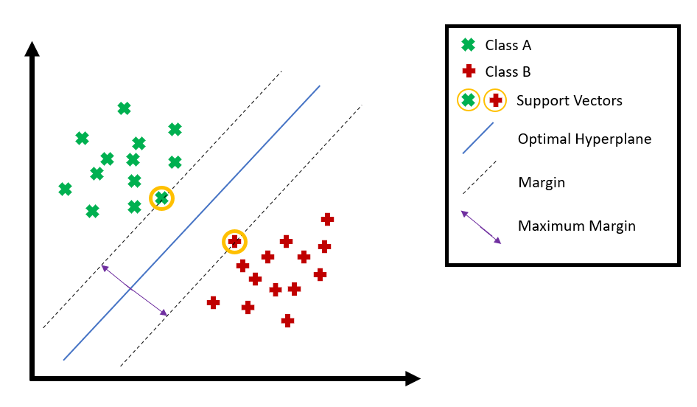
SVM Method Machine Learning
SVM utilises vectors within a dataset to find the most optimal hyperplane accompanied with a maximal marginal classifier. This allows for a method that is able to distinctly tell apart two different types of data points. When new data is added, the SVM is able to distinguish based on what side of the hyper plane it has fallen on.
SVM Advantages
-Works really well when the is a clear boundary of separation between different classes of data.
-Relatively memory efficient
- More effective in high dimensional spaces, meaning the is room for improvement in defining abuse.

Slide 8
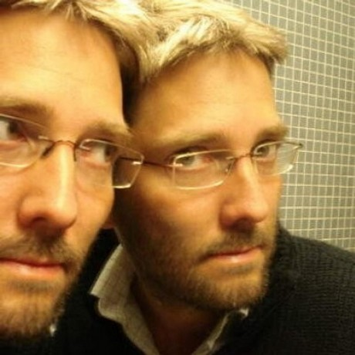
AFINN Lexicon
AFINN lexicon is a widely used English lexicon created by Finn Årup Nielsen between 2009 and 2011. The AFINN lexicon contains 3300 terms that have been labelled using a polarity system with a scale from -5 to +5. It is simple yet effective, seeing many use cases across the likes of Sentiment analysis.
This lexicon was used in this project as a representative of the Lexicon methodology. As an industry standard / popular lexicon it provided good insight into the benefits and drawbacks of Lexicon methods. While also allowing for a better understanding for the extent of success seen with the TFIDF Lexicon
Finn Årup Nielsen

Slide 9
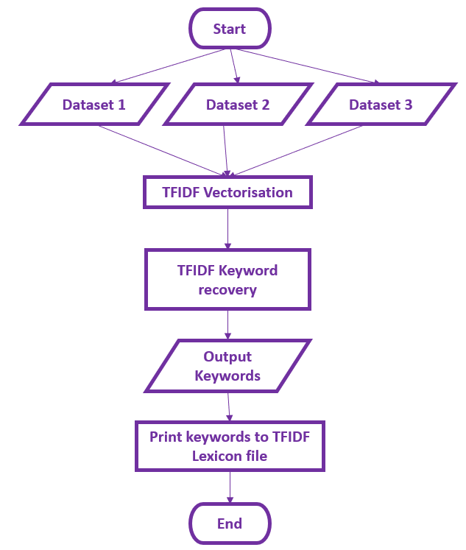
TFIDF Lexicon (Supervised learning)
TFIDF is a text feature extraction method that is able to extract keywords within a document. This use-case of the TFIDF theory, is loosely adopted in order to attempt to create a lexicon methodology through supervised learning. In theory this would allow for the generation of tailor-made lexicons applicable to any use case.
This project feeds TFIDF keyword extraction 3 datasets covering different definitions/classifications of abuse. By recovering key words from these documents it looks to utilise a lexicon approach to new unseen tweets.

Slide 10
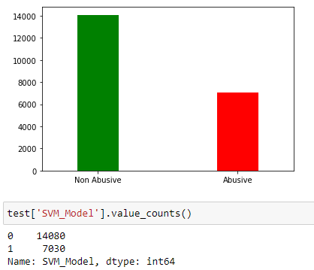
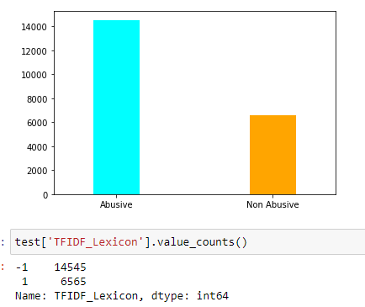
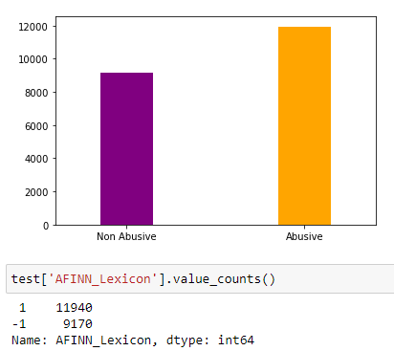
Validation testing
This project practices a double testing practice in order to garner a better understanding of the methods explored. This allows for a better comparison to be made backed by data. Validation testing is used in this project to create an earlier understanding of the success of the three methods. The validation testing fuelled the adjustment of methodology to increase results before going to a fully fledged survey. This included the likes of hyper parameter tuning and lexicon adjustment

Slide 11
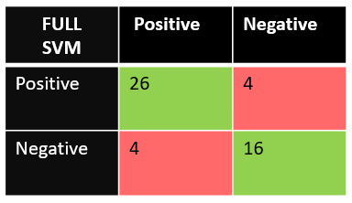
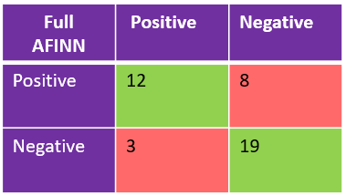
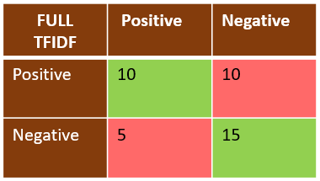
Survey
After adhering the final adjustments and parameter tuning the models are then put forward to a survey testing. This survey testing encompassed asking 5 anonymous participants to classify tweets whether they felt they were abusive in nature or not. These were tweets that had been collected and classified by the models using Tweepy. The were a total of 40 tweets with 20 being selected with less abusive terms and 20 more abusive in nature. This allowed for a final “results” evaluation of the success of the models. The participant results were used as true labels to determine when the model was correct and incorrect in its classifications.

Slide 12
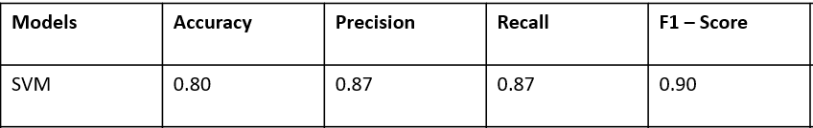
SVM Conclusion
The SVM Model showed the best results in the survey. However when analyzing some specific tweets and its miss classifications it is evident that the SVM model in this project ,is still far from being ready in a real-world application. The conclusion drawn in the project is that the SVM Model is heavily reliant on the quality of dataset used. The dataset used in this model was altered and adjusted using sampling to reduce computational times, due to this the SVM lacks in raw volume of data. Yet the original dataset pre sampling scores a measly 6.5 on Kaggle and suffers from a low “abusive “ volume of data limiting its total exposure to abuse recognition.
If the SVM method was to be pursued in future it would be ideal to create a better dataset containing larger amounts of data with a much more balanced ratio of data. Furthermore it would be best to create a dataset that endorses the use of additional features to take full advantage of SVM’s polynomial kernel tricks as well.

Slide 13
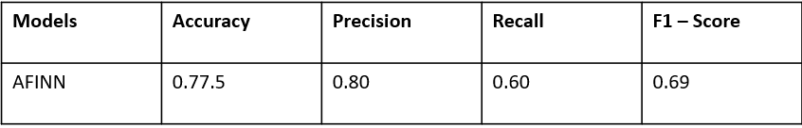
AFINN Conclusion
The AFINN Lexicon initially looked to display good results within the survey, but eventually it was evident that the AFINN Lexicon’s original use case was not suited well enough for the specifics of detecting only abuse. It worked well in portraying the overall sentiment of tweets but was not able to differentiate between Abusive content, and general negative sentiment.
Furthermore, lexicon methods are prone to miss classifications due to issues like sarcasm and context. Lexicons are not able to read these entities due to their methodology fundamental which looks to isolate words.

Slide 14
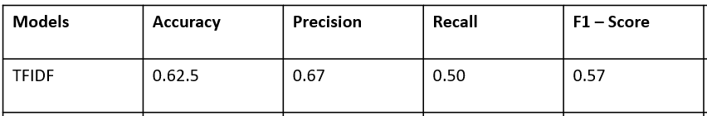
TFIDF Lexicon Conclusion
The TFIDF lexicon performed poorly in survey testing. This was most likely for a number of reasons. To create purer relevance words from TFIDF extraction it would be much more beneficial to adopt datasets that are more suited towards this concept as opposed to utilising machine learning datasets. It is clear through the actual lexicon that the TFIDF is selecting words of high importance that don’t represent Abuse but still relevant within the data. The way to counter this in future would be to use datasets of extreme abusive and non abusive content. This could be done in a future project where datasets are created using manual labelling that will highlight tweets as extremely abusive etc. This would create datasets of extremely high abusive content where TFIDFs recovered words will be full of purer sentiment.
Additionally it would be best suited to adopt polarity scores similar to the AFINN lexicon but with the definition being tailored towards abusive content. This would aid in countering the issue or sentiment purity/dilution skewing classifications

Slide 15
Future Works
In future the most significant implementations I would like to attempt would be creating a dataset from scratch using excessive filtering and manual labelling. Finding a suitable free dataset proved to be difficult. Additionally the benefits of creating one from scratch is it allows for a personal and clearer definition of abuse. While also allowing for the addition of categories like Racism, Islamophobia, homophobia etc. Defining this would give a proposed solution much more usability in a real world context.

Slide 16
Overall Conclusion
My project was able to demonstrate 2 methods that performed well to some extent in detecting abuse, being thoroughly tested on unseen data retrieved through the Twitter API. I used survey testing to back up my overall evaluation of the methods.
While exploring the possibility of a supervised learning lexicon , that I still believe is achievable with further improvements and adjustments.

